Slide 1
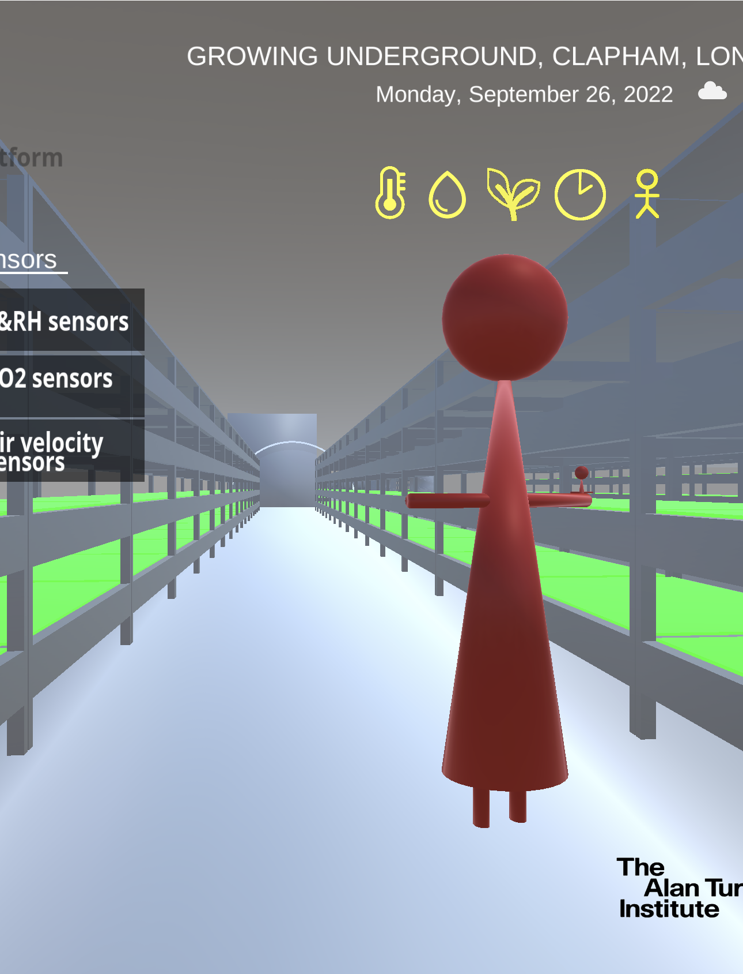
CROP
Markus Hauru
Nick Barlow, Tomas Lazauskas, Flora Roumpani, David Salvador-Jasin, May Yong

Slide 2
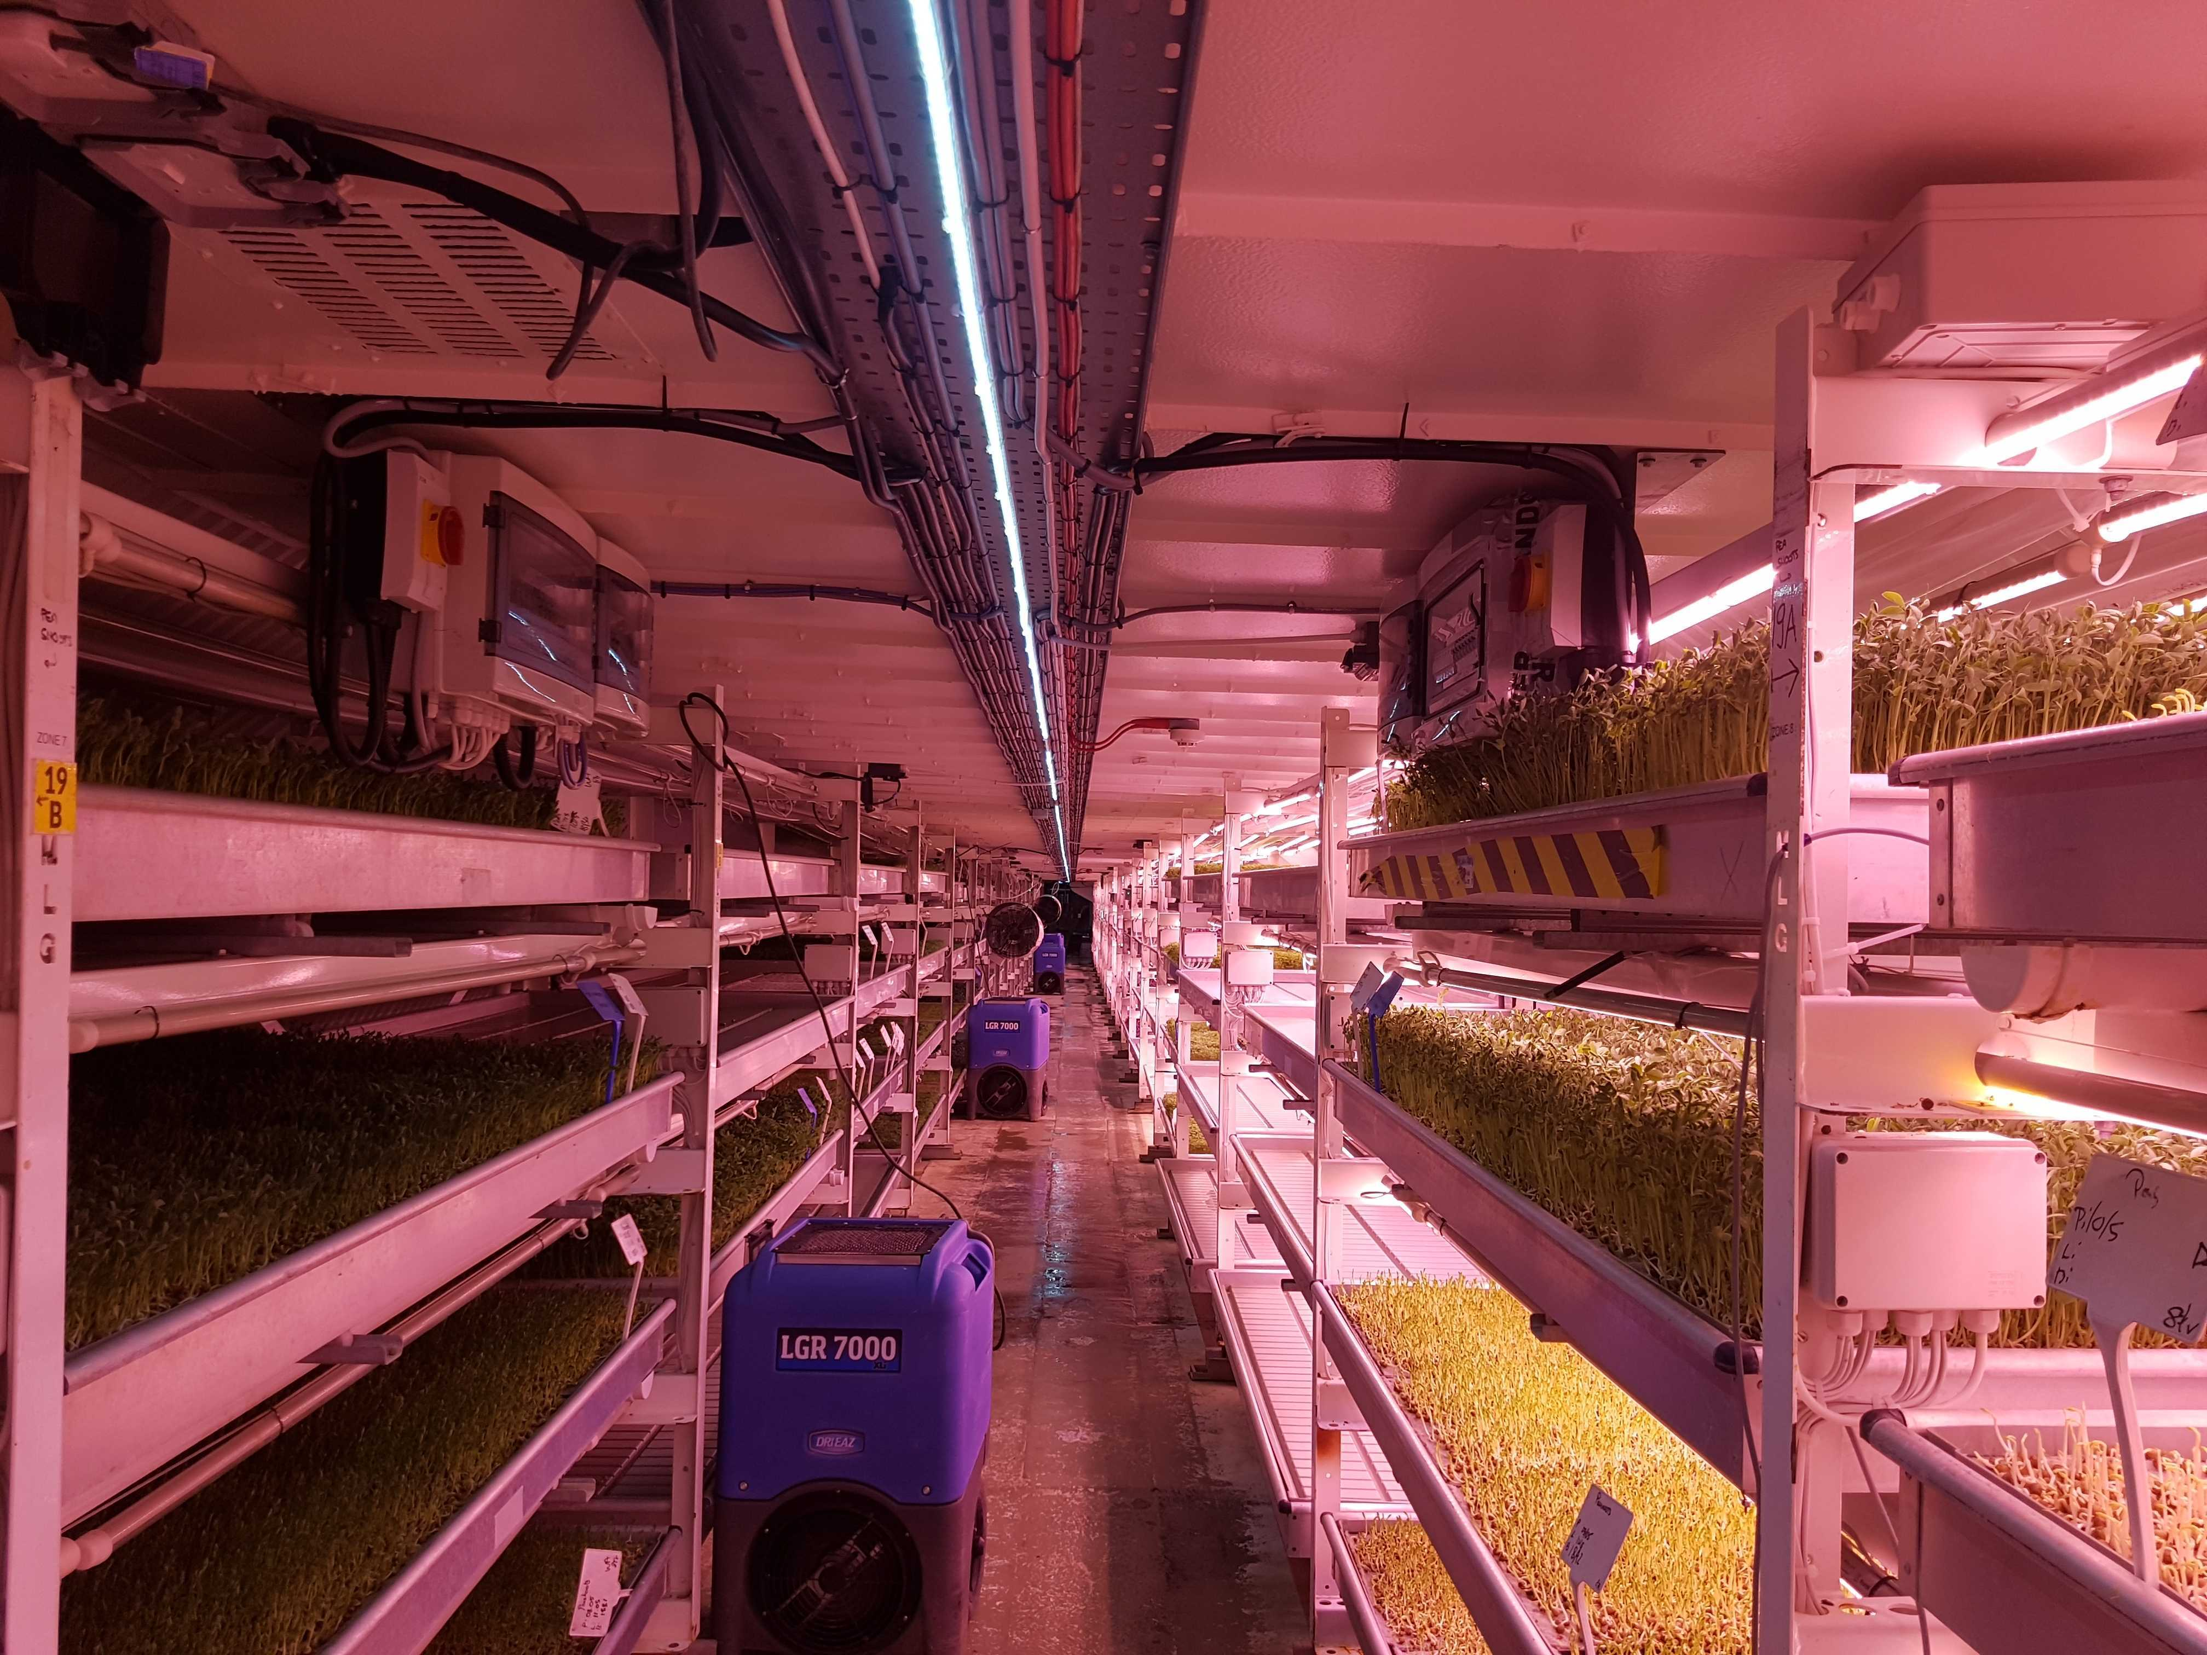
What is CROP?
Digital twin of an underground farm
Sensor readings
Crop yield data
Forecasting farm conditions
Fusion of the above

Slide 3


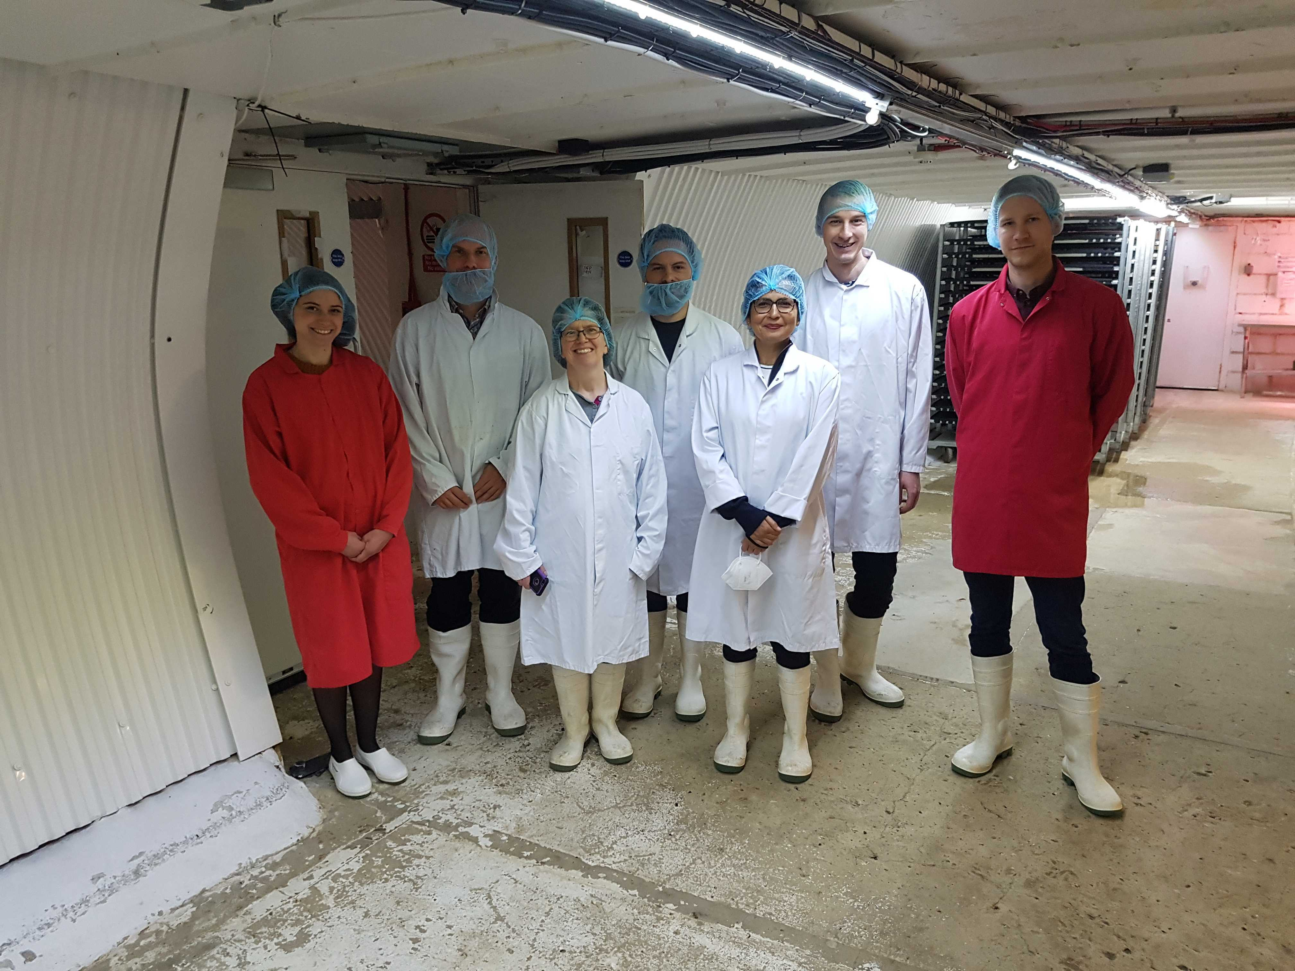


Collaboration
Prof. Ruchi Choudhary’s group
Research Engineering Group

Slide 4
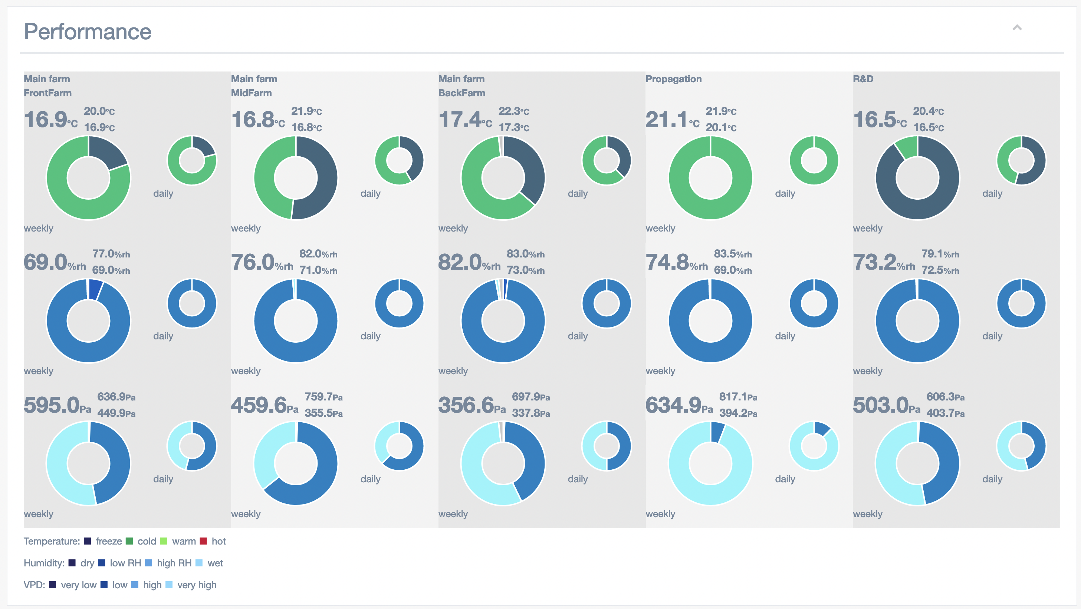

Slide 5
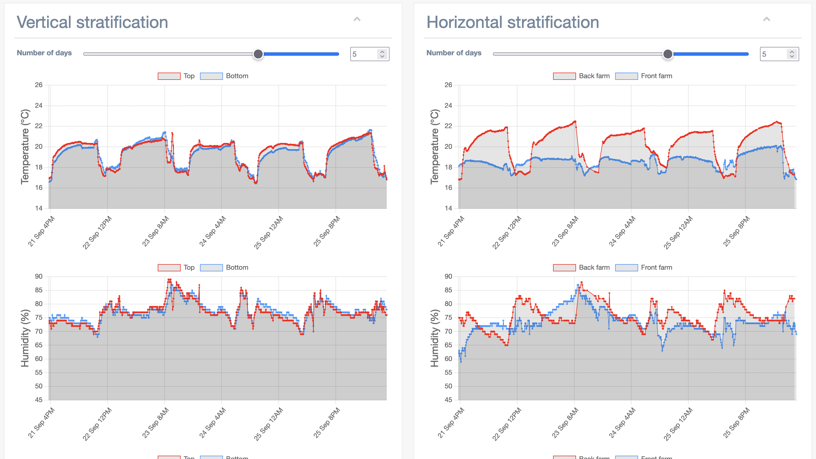

Slide 6
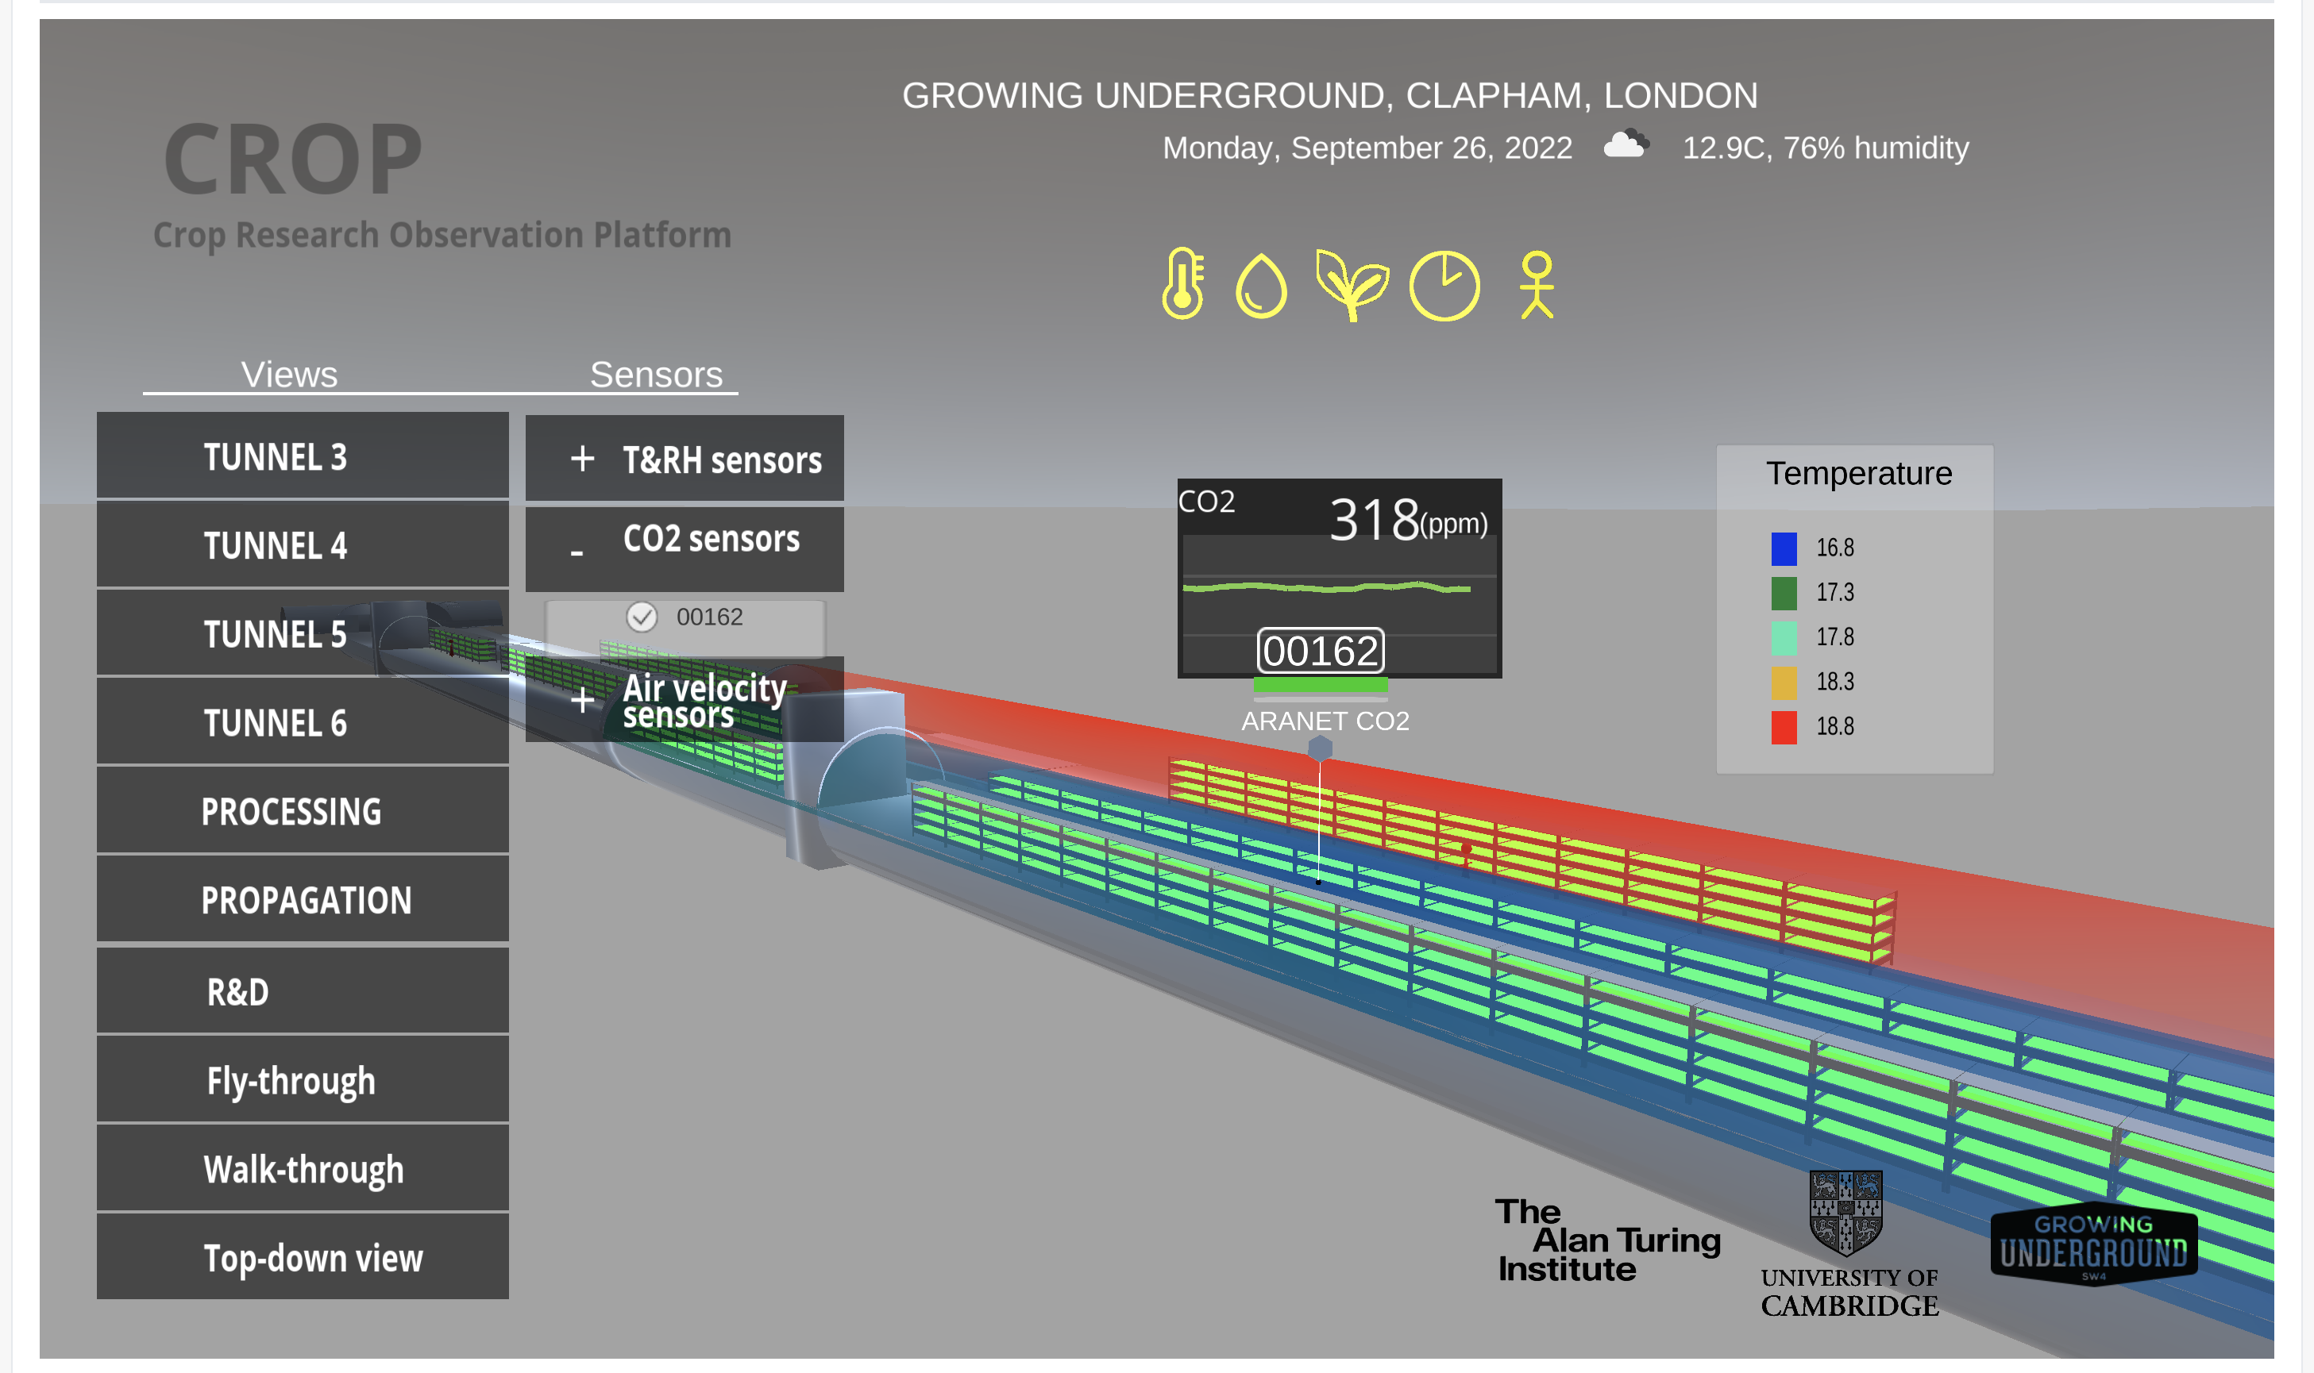

Slide 7
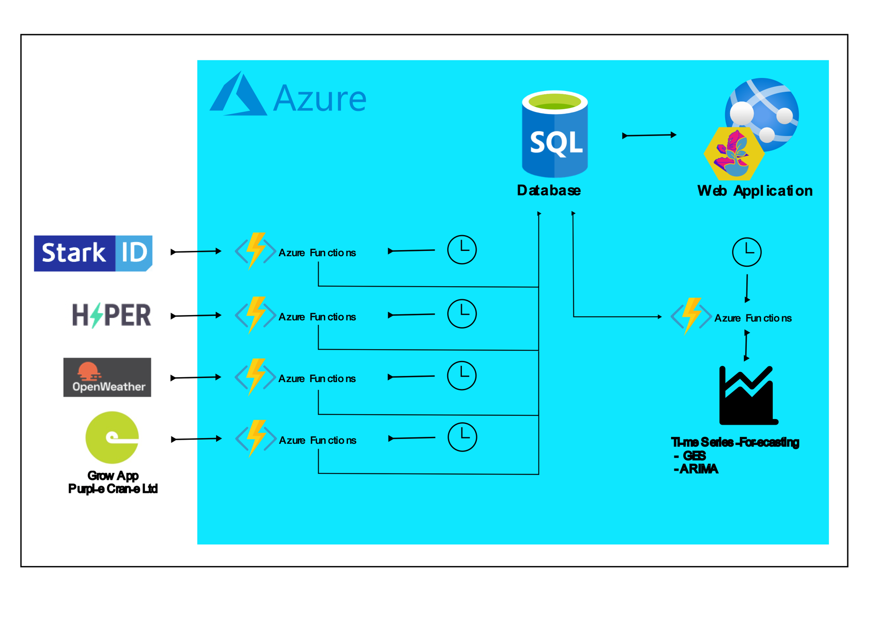
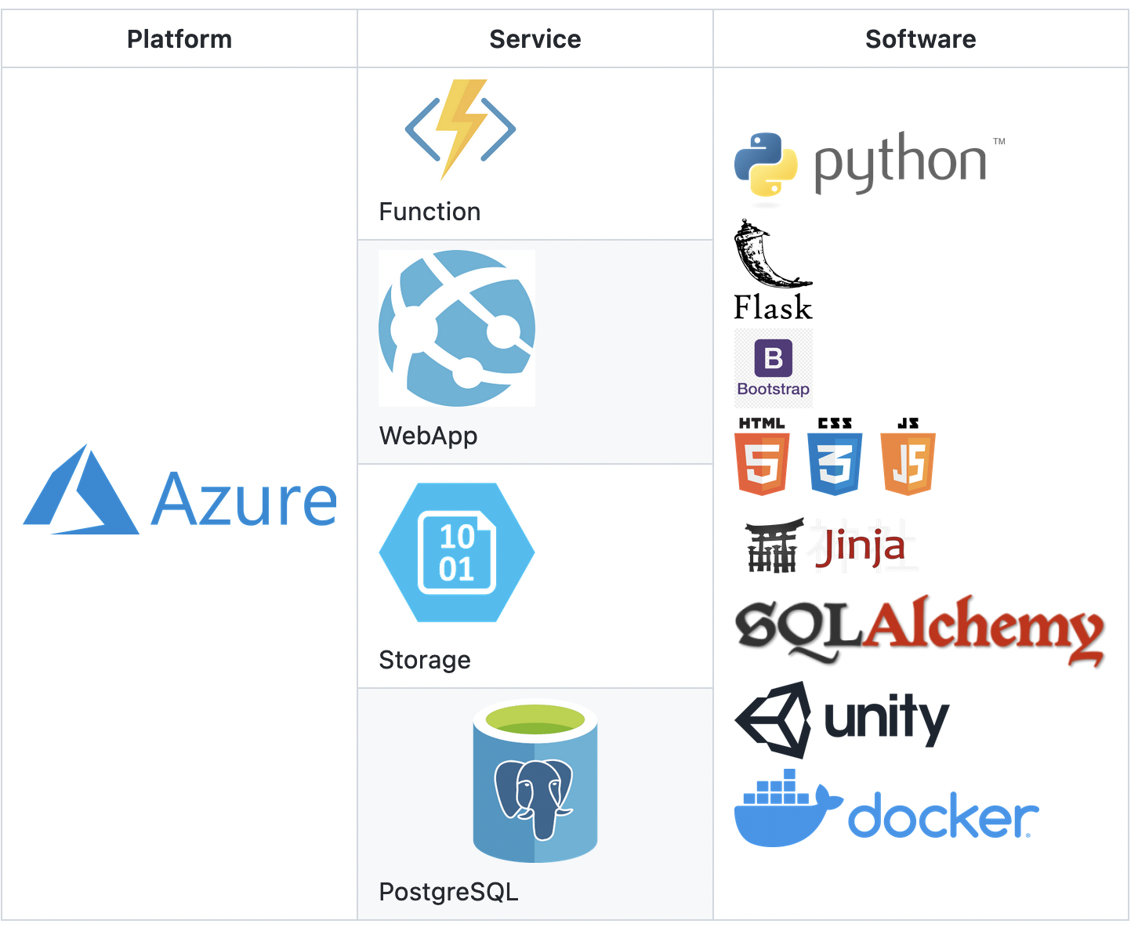
Infrastructure
https://github.com/alan-turing-institute/CROP

